Slide 1
Introduction to Relational Databases (2)

Slide 2
What you will learn
The basics of SQL joins
Overview of NoSQL databases
Differences between SQL and NoSQL

Slide 3
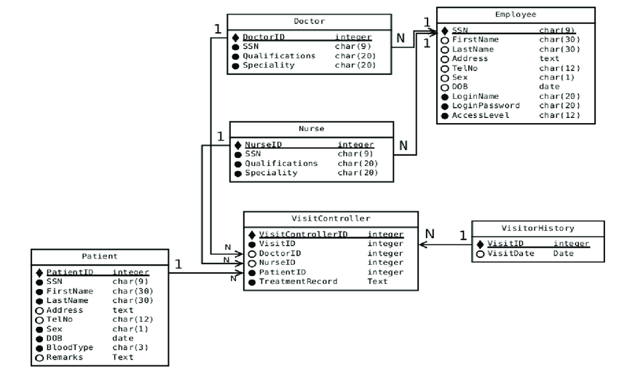
Quick reminder
Relational Databases are used to
Store data
Organize data logically through relationhips
Access and manage data through relationships with SQL language

Slide 4
Quick reminder
Knight
id
lastname
firstname
age
Data is stored in 2D tables whose intersections are called fields.
Each row is a tuple that has a unique identifier: the primary key.
Databases are managed with Database Management Systems (relational or not) (DBMS)
id | lastname | firstname | age
1 | Pendragon | Arthur | 40
2 | Le gallois | Perceval | 32
3 | Du Lac | Lancelot | 35

Slide 5
SQL Joins

Slide 6
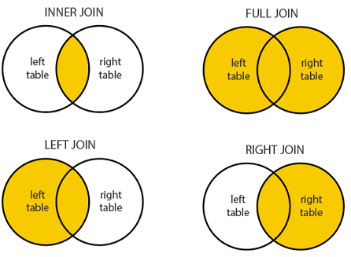
SQL Joins
What for?
Joins are the SQL commands used to combine rows from two or more tables, based on a related column between those tables.
-> Where do clients who order our premium services live?

Slide 7
SQL Joins
Different types of joins
Inner join
Left join
Right join
Full outer join

Slide 8
SQL Joins
Inner join
The INNER JOIN or simply JOIN returns those records which have matching values in both tables.
Syntax
SELECT Table1.Column1,Table1.Column2,Table2.Column1,....
FROM Table1
INNER JOIN Table2
ON Table1.MatchingColumnName = Table2.MatchingColumnName;

Slide 9
SQL Joins
Left join
The LEFT JOIN or the LEFT OUTER JOIN returns all the records from the left table and also the records which satisfy a condition from the right table.
For the records with no matching values in the left table, will contain the NULL value in the output
Syntax
SELECT Table1.Column1,Table1.Column2,Table2.Column1,....
FROM Table1
LEFT JOIN Table2
ON Table1.MatchingColumnName = Table2.MatchingColumnName;

Slide 10
SQL Joins
Right join
The RIGHT JOIN or the RIGHT OUTER JOIN returns all the records from the right table and also those records which satisfy a condition from the left table.
For the records with no matching values in the left table, will contain the NULL value in the output
Syntax
SELECT Table1.Column1,Table1.Column2,Table2.Column1,....
FROM Table1
RIGHT JOIN Table2
ON Table1.MatchingColumnName = Table2.MatchingColumnName;

Slide 11
SQL Joins
Full outer join
Full Join or the Full Outer Join returns all records which either have a match in the left(Table1) or the right(Table2) table.
Syntax
SELECT Table1.Column1,Table1.Column2,Table2.Column1,....
FROM Table1
FULL JOIN Table2
ON Table1.MatchingColumnName = Table2.MatchingColumnName;

Slide 12
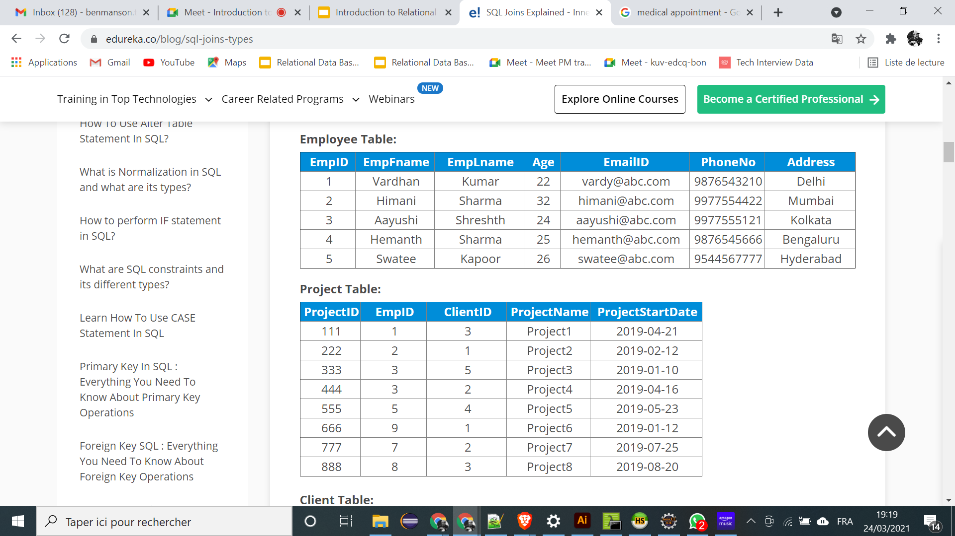
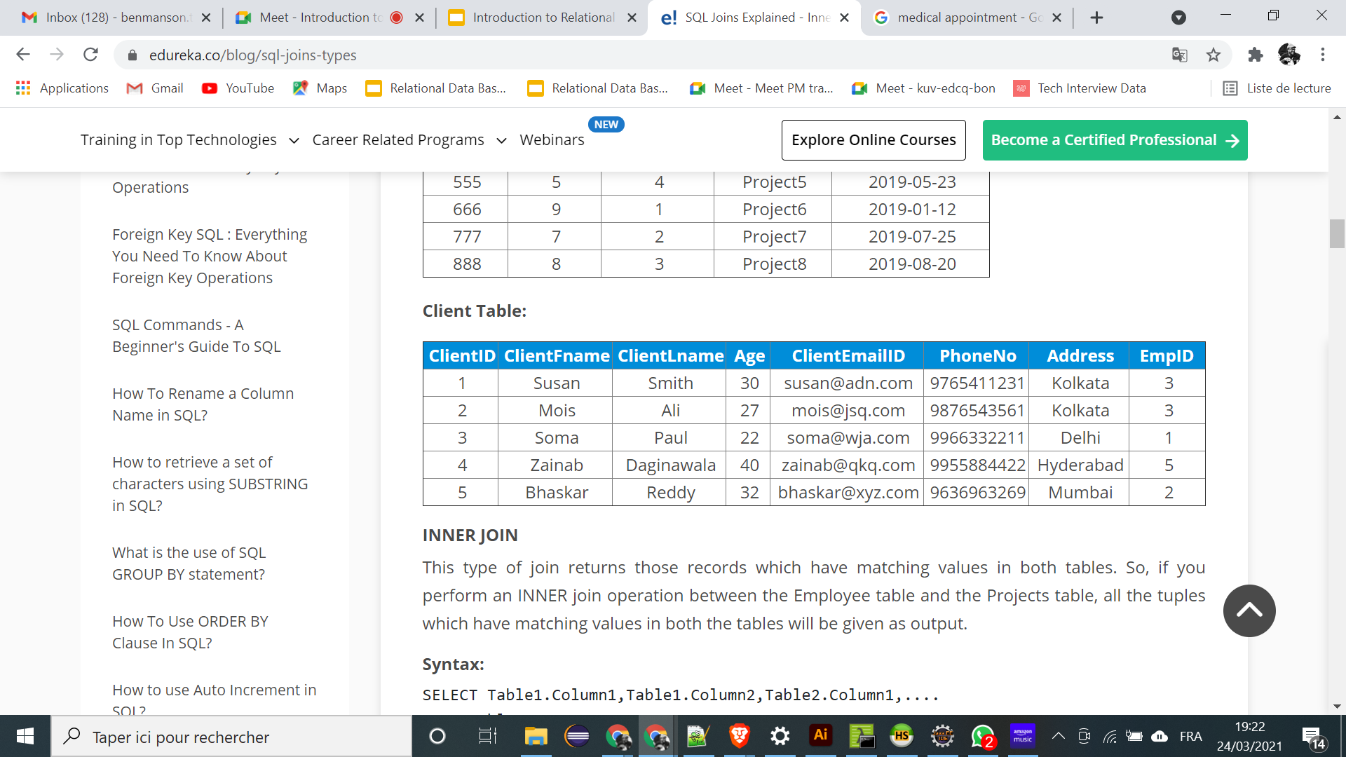
SQL Joins
What project are employees working on?

Slide 13
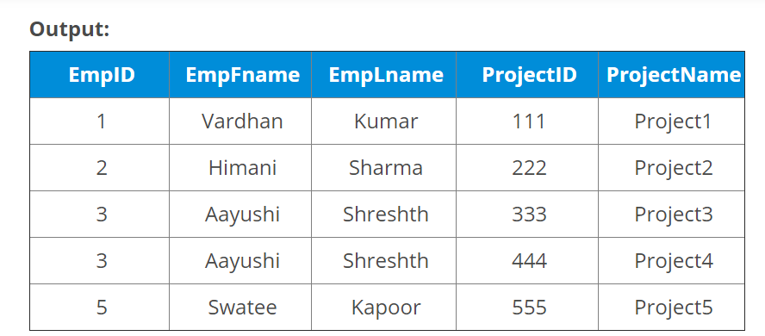
SQL Joins
SELECT Employee.EmpID, Employee.EmpFname, Employee.EmpLname, Projects.ProjectID, Projects.ProjectName
FROM Employee
INNER JOIN Projects ON Employee.EmpID=Projects.EmpID;

Slide 14

SQL Joins
Normalization
Normalization is a key principle of SQL databases
Avoids redundancy: the information is written once and then referenced using a foreign key.
Fosters database maintenance: the lack of redundancy allows information to be updated more quickly.
-> Basis of the join system

Slide 15
SQL vs NoSQL

Slide 16
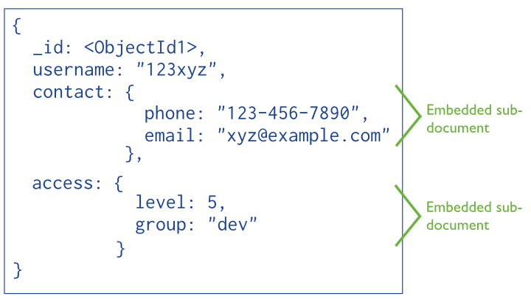
SQL vs NoSQL
SQL Databases
Entity-Relationships
Structured data schema
NoSQL Databases
DataBase without SQL
Unstructured or semi-structured data schema

Slide 17
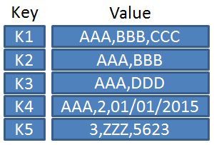
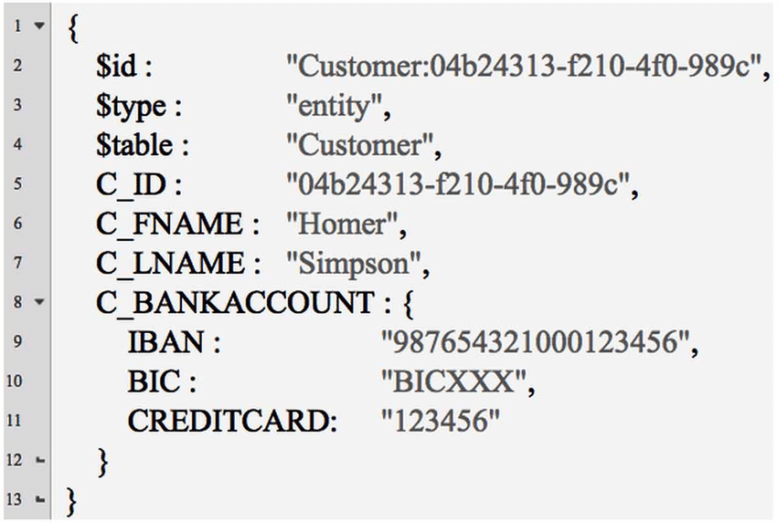
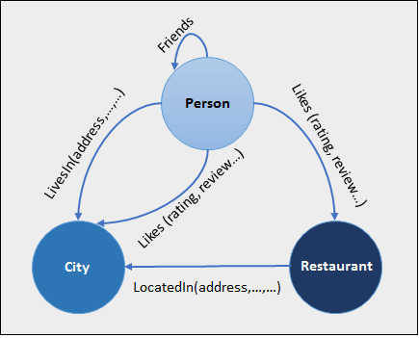
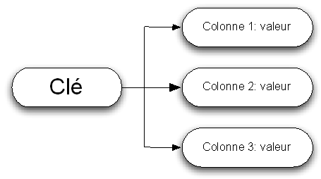






Different types of NoSQL
Key-Value | Document Based | Column Based | Graph Based
Good for the flexibility of the data schema and the simplicity of horizontal scaling.
Notes:
Key-Value Store: A data is accessible by its key (ID).
Document Based Store: Data is stored in sets. Works like a Key-Value Store but offers the possibility to make some queries and aggregations (especially with MapReduce)
Column Based Store: Extremely Fast search and aggregation
Graph Based: Graph oriented database, it allows to define adjacencies between data.

Slide 18
ACID vs CAP
NoSQL = CAP
Consistency
Availability
Partition
Only two of the three principles can be satisfied.
(Most often, availability and partitioning are prioritized over consistency)
SQL = ACID
Atomicity
Consistency
Isolation
Durability
Ensures that a computer transaction is executed reliably.
The 4 principles can be satisfied
Notes:
Key-Value Store: Une donnée est accessible par sa clé (ID)
Document Based Store: Les données sont stockés par ensemble. Fonctionne comme une Key-Value Store mais offre la possibilité de faire quelques requêtes et des agrégations (notamment avec MapReduce)
Column Based Store: Extremely Fast search and aggregation
Graph Based: Base de données orienté graphe, elle permet de définir des adjacences entre les données

Slide 19
SQL vs NoSQL
Denormalization
Due to the absence an efficient join system, denormalization is often applied when modeling NoSQL databases.
This is the exact opposite of normalization:
Data is redundant
Fosters quick access times
-> compromises storage size

Slide 20

SQL vs NoSQL
SQL is best suited when :
The data structure can be identified in advance
Data integrity is essential, and more important than speed.
The transactional nature is strongly present
Example: A slow trading site, but whose stock is calculated in real time between all servers for all products.

Slide 21

SQL vs NoSQL
NoSQL is best suited when :
The structure of the data is independent, indeterminate and scalable.
The structure requires a high degree of agility
Speed trumps integrity
Example: A fast e-commerce site, but with inconsistent inventory contingencies.

Slide 22
Practice

Slide 23

Group work
Product and data structure
Your product: a platform that manages appointments between patients and doctors
What are the main features of this tool?
What type of key insights could you be willing to get from the data?
What will the database look like?

Slide 24
Train further

Slide 25

Train further
The SQL Murder Mystery
There's been a Murder in SQL City!
The SQL Murder Mystery is designed to be both a self-directed lesson to learn SQL concepts and commands and a fun game for experienced SQL users to solve an intriguing crime.
https://mystery.knightlab.com/

Slide 26
Resources

Slide 27
Resources
https://www.studytonight.com/dbms/
https://www.w3schools.com/sql/
https://www.w3schools.com/sql/trysql.asp?filename=trysql_select_all
https://www.departmentofproduct.com/blog/sql-skills-for-product-managers/
https://www.jdoodle.com/execute-sql-online/
https://macrocosme.github.io/db_sql.html
https://www.edureka.co/blog/sql-joins-types
https://mystery.knightlab.com/
https://www.getlore.io/knowledgecenter/data-standardization

